Slide 1


Scalable Data Science with Hadoop, Spark and R
Mrinal Chakraborty
Data Insights Team
Microsoft India
Programing: SAS, R-Server, TensorFlow and Scala
Big-Data: Cloudera Hadoop certification and Spark Ecosystem
Machine learning: Logistic Regression, Neural Networks, Support vector machines, XGBoost, Classification and Association rules
Allied Analytics skills: Visualisation, Marketing & Web analytics
Certifications: PMP, Certified Scrum Master & Certified in Business analytics from Indian School of Business http://www.isb.edu/cba/

Slide 2











Microsoft R Server
Cloud
Hadoop & Spark
R Server portfolio
R Server Technology
EDW
RDBMS
Desktops & Servers

Slide 3
R Server “Parallel External Memory Algorithms” (PEMAs)
The initial ze() method of the master Pema object is executed
The master Pema object is serialized and sent to each worker process
The worker processes call processData() once for each chunk of data
The fields of the worker’s Pema object are updated from the data
In addition, a data frame may be returned from processData(), and will be written to an output data source
When a worker has processed all of its data, it sends its reserialized Pema object back to the master (or an intermediate combiner)
The master process loops over all of the Pema objects returned to it, calling updateResults() to update its Pema object
processResul s() is then called on the master Pema object to convert intermediate results to final results
hasConverged(), whose default returns TRUE, is called, and either the results are returned to the user or another iteration is started
3

Slide 4
R Script for Execution in MapReduce
Define Compute Context
Sample R Script:
Define Data Source
rxSetComputeContext( RxHadoopMR(…) )
inData <- RxTextData(“/ds/AirOnTime.csv”, fileSystem = hdfsFS)
model <- rxLogit(ARR_DEL15 ~ DAY_OF_WEEK + UNIQUE_CARRIER, data = inData)
Train Predictive Model

Slide 5
Easy to Switch From MapReduce to Spark
Change the Compute Context
Sample R Script:
Keep other code unchanged
rxSetComputeContext( RxSpark(…) )

Slide 6
R Server: scale-out R
100% compatible with open source R
Any code/package that works today with R will work in R Server
Wide range of scalable and distributed R functions
Examples: rxDataStep(), rxSummary(), rxGlm(), rxDForest(), rxPredict()
Ability to parallelize any R function
Ideal for parameter sweeps, simulation, scoring

Slide 7










Parallelized & Distributed Algorithms
ETL
Data import – Delimited, Fixed, SAS, SPSS, OBDC
Variable creation & transformation Recode variables
Factor variables Missing value handling Sort, Merge, Split
Aggregate by category (means, sums)
Statistical Tests
Chi Square Test
Kendall Rank Correlation Fisher’s Exact Test Student’s t-Test
Machine Learning
Decision Trees Decision Forests
Gradient Boosted Decision Trees Naïve Bayes
▪
▪
▪
▪
▪
▪
▪
▪
▪
▪
▪
▪
▪
▪
▪
Predictive Statistics
Sum of Squares (cross product matrix for set variables)
Multiple Linear Regression
Generalized Linear Models (GLM) exponential family distributions: binomial, Gaussian, inverse Gaussian, Poisson, Tweedie. Standard link functions: cauchit, identity, log, logit, probit. User defined distributions & link functions.
Covariance & Correlation Matrices Logistic Regression Predictions/scoring for models Residuals for all models
Clustering
K-Means
▪
▪
▪
Descriptive Statistics
Min / Max, Mean, Median (approx.) Quantiles (approx.)
Standard Deviation Variance Correlation Covariance
Sum of Squares (cross product matrix for set variables)
Pairwise Cross tabs
Risk Ratio & Odds Ratio
Cross-Tabulation of Data (standard tables & long form)
Marginal Summaries of Cross Tabulations
▪
▪
Sampling
Subsample (observations & variables) Random Sampling
▪
▪
▪
▪
▪
▪
▪
▪
Simulation
Simulation (e.g. Monte Carlo) Parallel Random Number Generation
▪
▪
▪
▪
▪
▪
▪
▪
▪
Custom Parallelization
rxDataStep rxExec PEMA-R API
Variable Selection
Stepwise Regression
▪
▪
▪
▪
▪

Slide 8



















R Server Hadoop Architecture
Data in Distributed Storage
R process on Edge Node
Master R process on Edge Node
Apache YARN and Spark
R Server
Worker R processes on Data Nodes

Slide 9











R Server for Hadoop - Connectivity
Remote Execution:
ssh Edge Node
Worker Task
ssh or R Tools for Visual Studio
https://
R Server Master Task
Initiator
Worker Task
Thin Client IDEs
Finalizer
https://
Worker Task
Jupyter Notebooks
Web Services
DeployR
BI Tools & Applications

Slide 10

HDInsight + R Server: Managed Hadoop for Advanced Analytics in the Cloud
R
Easy setup, elastic, SLA
Spark
Integrated notebooks experience
Upgraded to latest Version 2.0
R Server
Leverage R skills with massively scalable algorithms and statistical functions
Reuse existing R functions over multiple machines
SparkR functions
RevoScaleR functions
Spark and Hadoop
Blob Storage Data Lake Storage

Slide 11
R Server on Hadoop/HDInsight scales to hundreds of nodes, billions of rows and terabytes of data
Logistic Regression on NYC Taxi Dataset
2.2 TB
Elapsed Time
0
1
2
3
4
5 6 7
8
9 10 11 12 13
Billions of rows

Slide 12










Typical advanced analytics lifecycle
Prepare
Model
Operationalize

Slide 13
Airline Arrival Delay Prediction Demo
Clean/Join – Using SparkR from R Server
Train/Score/Evaluate – Scalable R Server functions
Deploy/Consume – Using AzureML from R Server

Slide 14
Airline data set
Passenger flight on-time performance data from the US Department of Transportation’s TranStats data collection
>20 years of data
300+ Airports
Every carrier, every commercial flight
http://www.transtats.bts.gov

Slide 15
Weather data set
Hourly land-based weather observations from NOAA
> 2,000 weather stations
http://www.ncdc.noaa.gov/orders/qclcd/

Slide 16
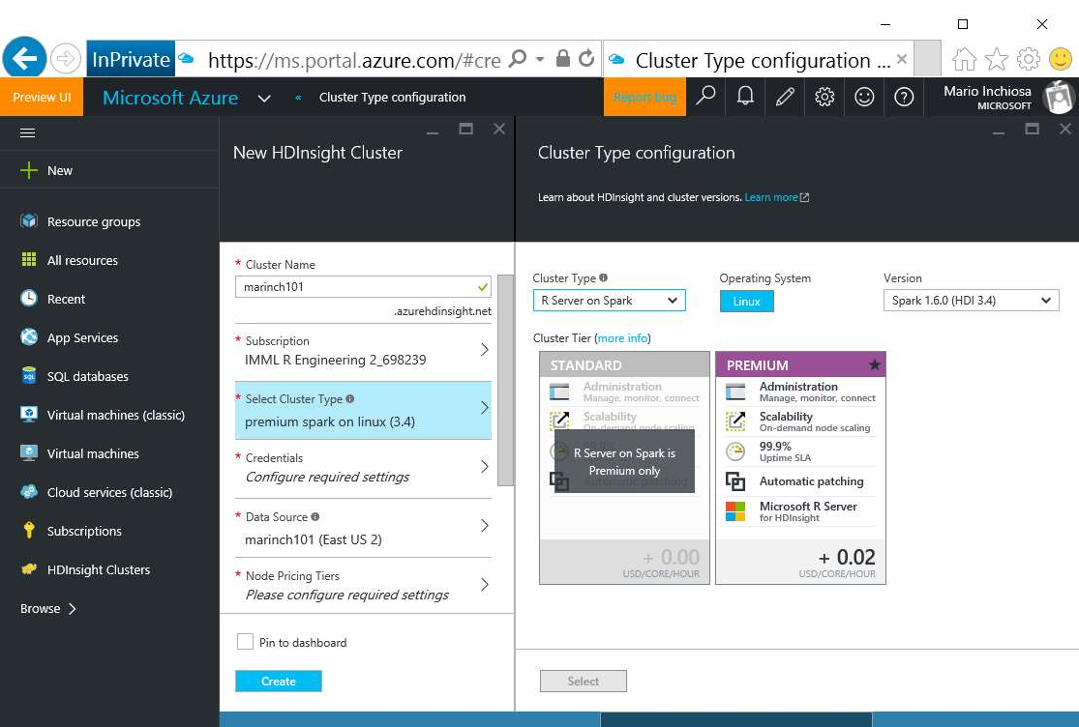
Provisioning a cluster with R Server

Slide 17
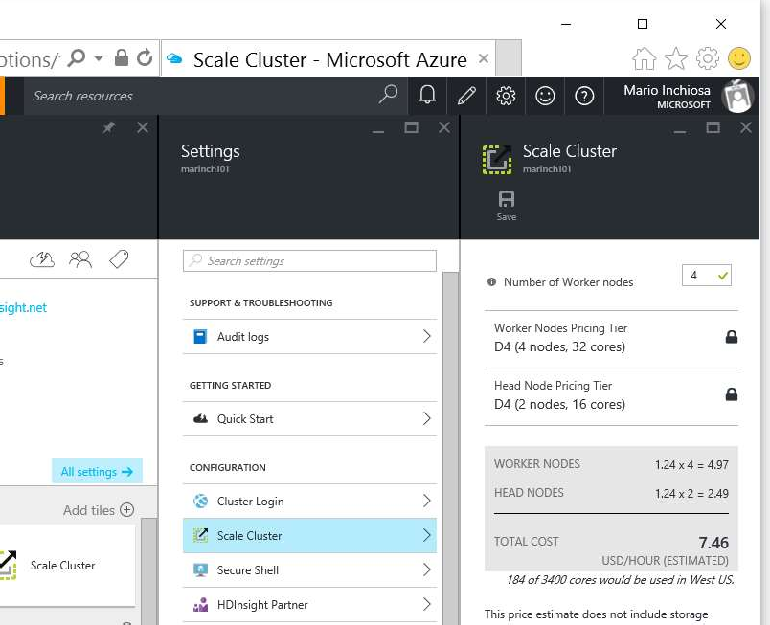
Scaling a cluster

Slide 18
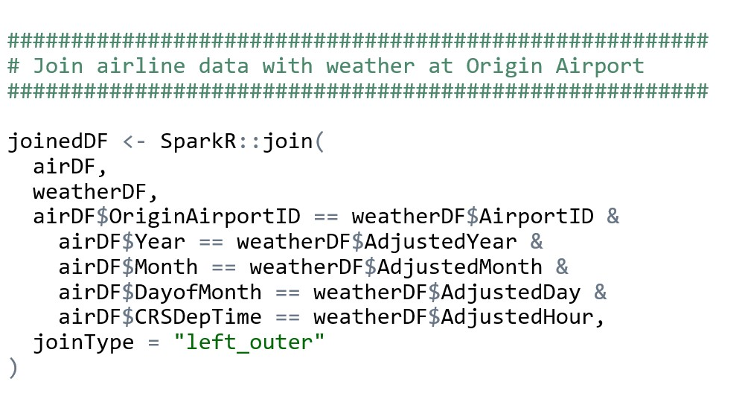
Clean and Join using SparkR in R Server

Slide 19
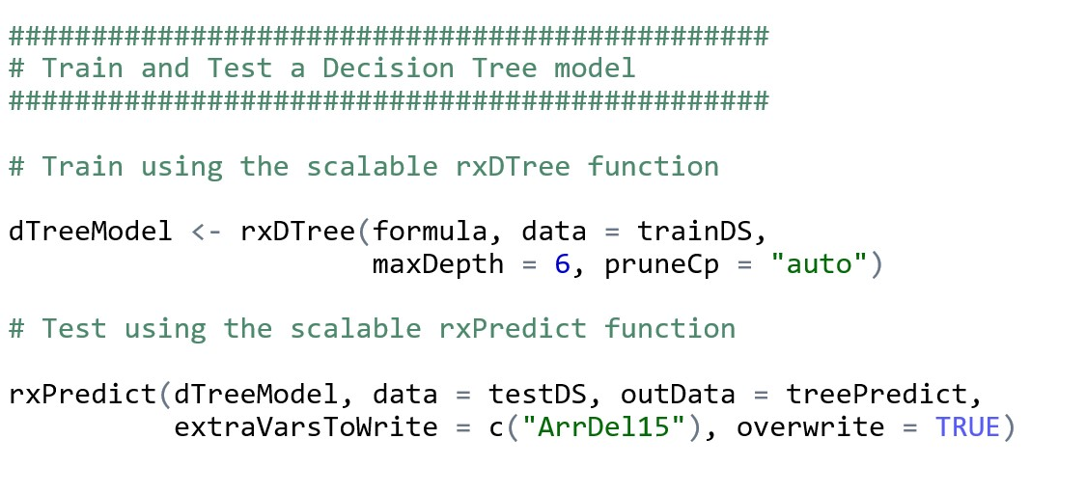
Train, Score, and Evaluate using R Server

Slide 20
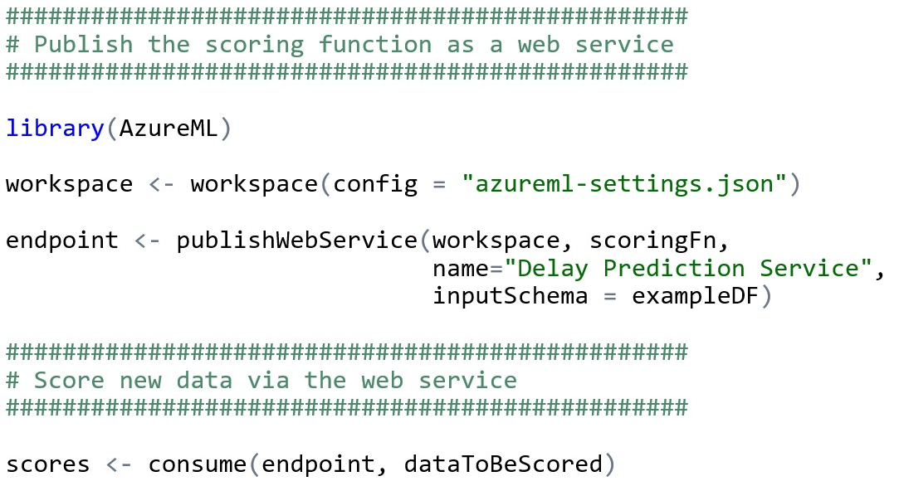
Publish Web Service from R

Slide 21
Demo Technologies
HDInsight Premium Hadoop cluster
Spark on YARN distributed computing
R Server R interpreter
SparkR data manipulation functions
RevoScaleR Statistical & Machine Learning functions
AzureML R package and Azure ML web service

Slide 22
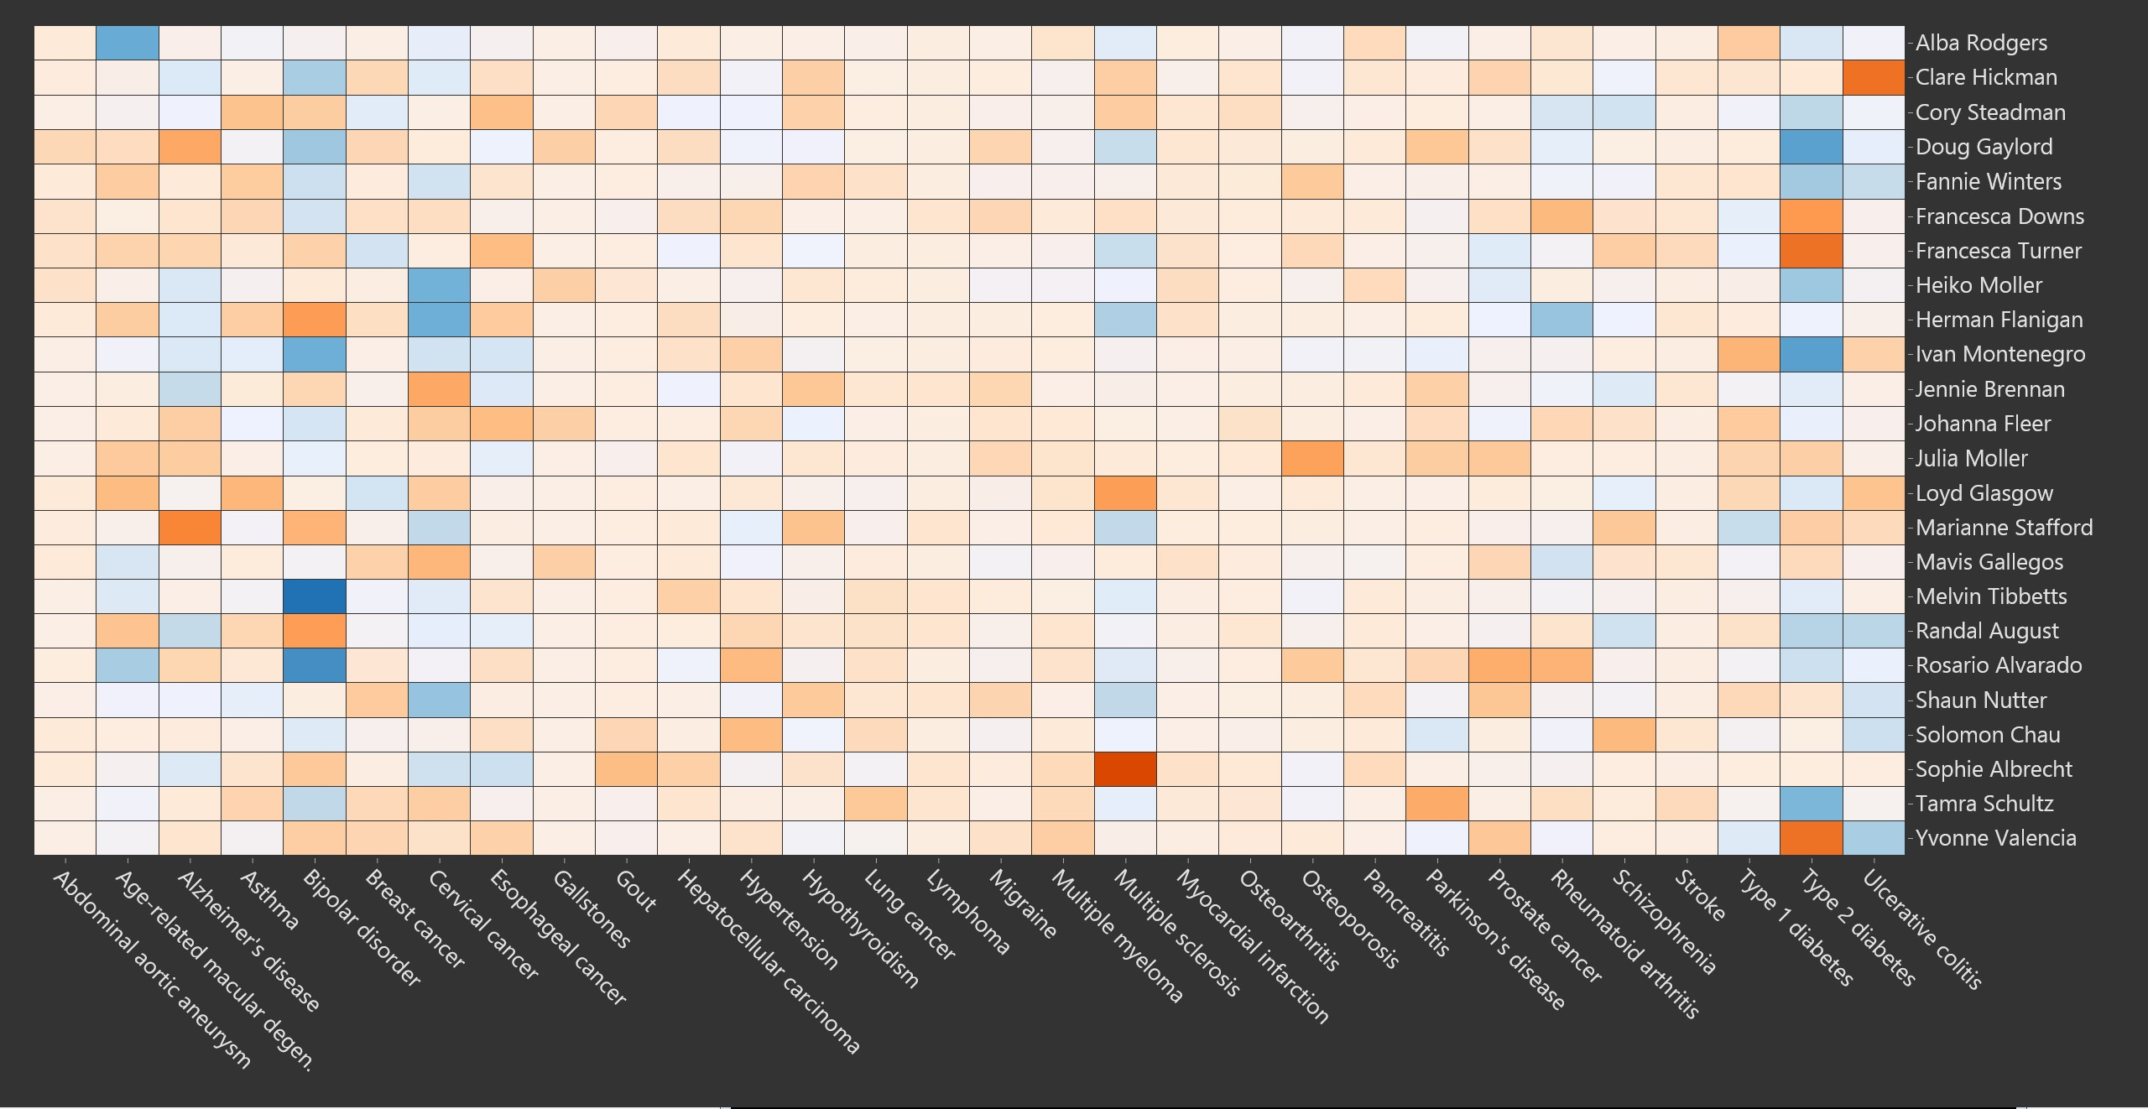
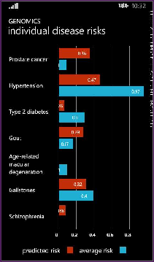
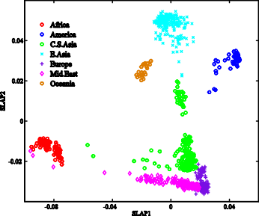
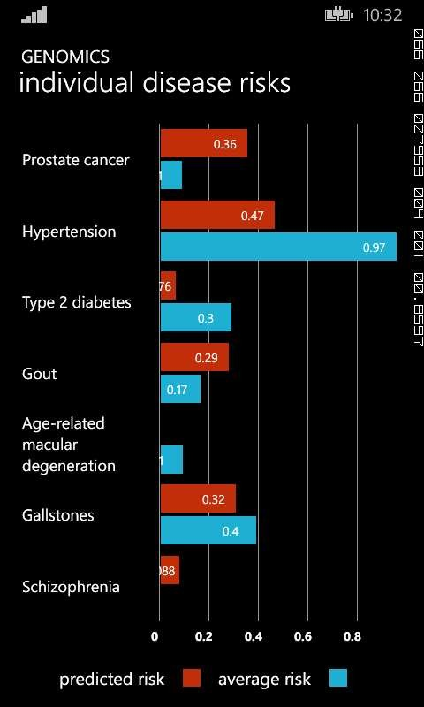





Building a genetic disease risk application with R
BAM
BAM
BAM
BAM
BAM
Data
Public genome data from 1000 Genomes
About 2TB of raw data
VariantTools
Platform
HDInsight Hadoop (8 clusters)
1500 cores, 4 data centers
Microsoft R Server
GWAS
Processing
VariantTools R package (Bioconductor)
Match against NHGRI GWAS catalog
Analytics
Disease Risk
Ancestry
Presentation
Expose as Web Service APIs
Phone app, Web page, Enterprise applications

Slide 23

microsoft.com/r-server
microsoft.com/hdinsight

